Slide 1
0x403 – Function Calls
ECED4406 – Computer Security
Dr. Colin O’Flynn
Dalhousie University.

Slide 2
Function Calls
Calling convention is how various function calls pass arguments.
Calling conventions vary for architectures & compilers.
Can find calling convention information (normally) in compiler documentation.
Functions themselves will normally do setup &

Slide 3
Example: avr-gcc calling convention
Function call conventions:
Arguments - allocated left to right, r25 to r8.
All arguments are aligned to start in even-numbered registers (odd-sized arguments, including char, have one free register above them). This allows making better use of the movw instruction on the enhanced core.
If too many, those that don't fit are passed on the stack.
Return values:
8-bit in r24 (not r25!)
16-bit in r25:r24
up to 32 bits in r22-r25
up to 64 bits in r18-r25
8-bit return values are zero/sign-extended to 16 bits by the called function (unsigned char is more efficient than signed char - just clr r25).
Arguments to functions with variable argument lists (printf etc.) are all passed on stack, and char is extended to int.
https://www.nongnu.org/avr-libc/user-manual/FAQ.html

Slide 4
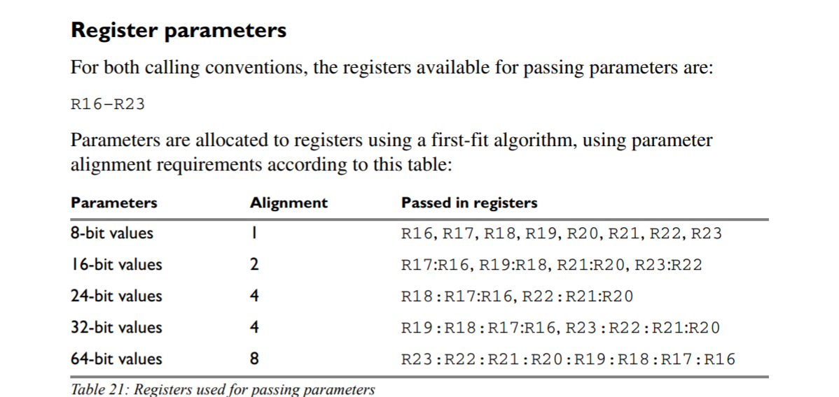
Example IAR avr calling convention
Recognizing calling conventions
http://ftp.indes.com/pub/mirrors/ftp.iar.se/WWWfiles/avr/webic/doc/EWAVR_CompilerGuide.pdf
Flip to page 159

Slide 5
Calling Convention – Different Compilers
Calling convention of the two compilers is different, even with same target (AVR in this case).
Recognizing calling conventions important for reverse engineering.

Slide 6
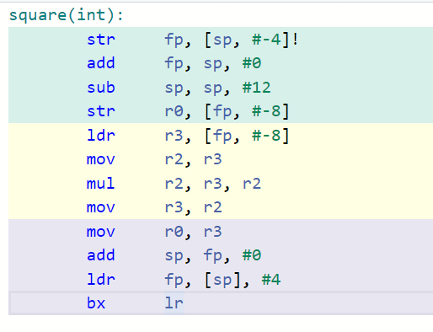
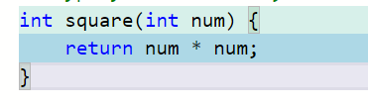
Recognizing function calls
We can see call to function.
We normally see return at end of function.
..What about in between?
return

Slide 7
Function Calls
Much of this deals around the usage of the stack – this should have been covered in your computer architecture classes.
If you need a refresher: https://azeria-labs.com/functions-and-the-stack-part-7/

